Slide 1
OPERATOR FRAMEWORK

Slide 2
What is an Operator
An Operator is a method of packaging, deploying and managing a Kubernetes application. A Kubernetes application is an application that is both deployed on Kubernetes and managed using the Kubernetes APIs and kubectl tooling.
Operators make it easy to manage complex stateful applications on top of Kubernetes. However writing an Operator today can be difficult because of challenges such as using low level APIs, writing boilerplate, and a lack of modularity which leads to duplication.
Components of the Operator Framework,
Operator SDK
Operator Life Cycle Manager
Operator metering
More on operator-sdk https://docs.google.com/document/d/1R5UOeu15qZwH-hvayRQ983uxO-zfEE7g84YpsmDcsYQ/edit

Slide 3
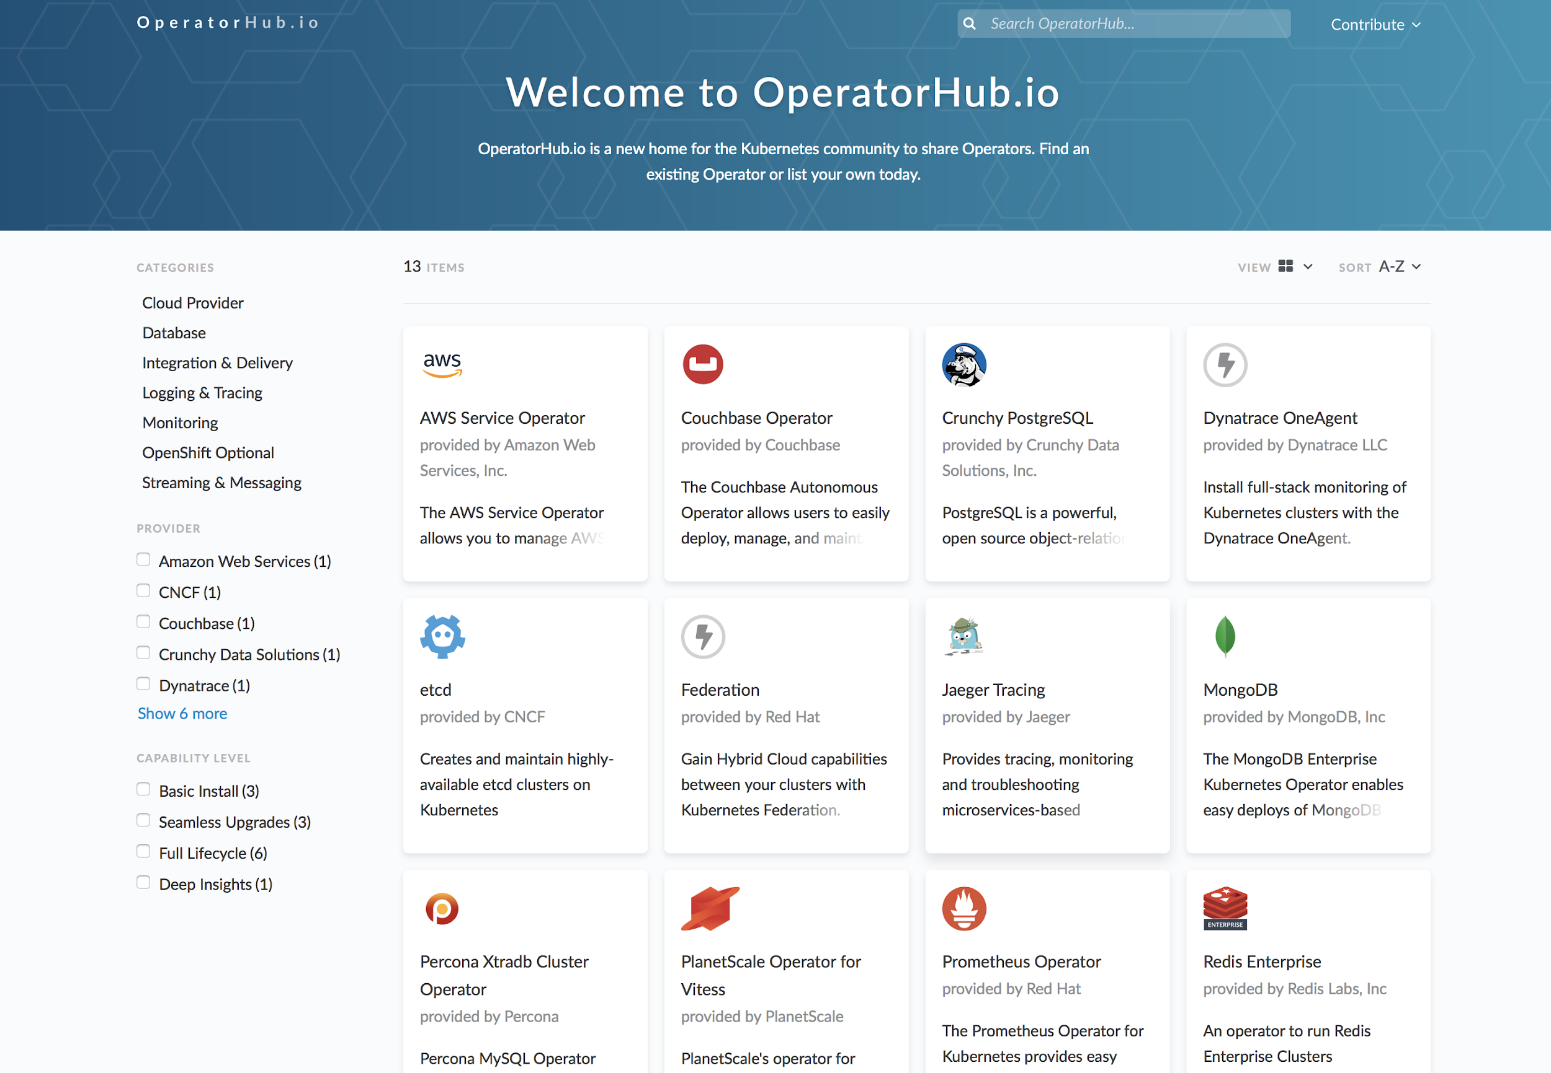
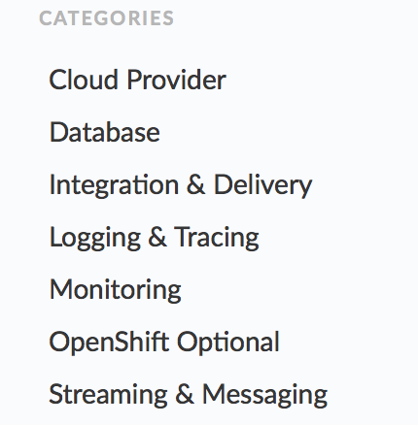
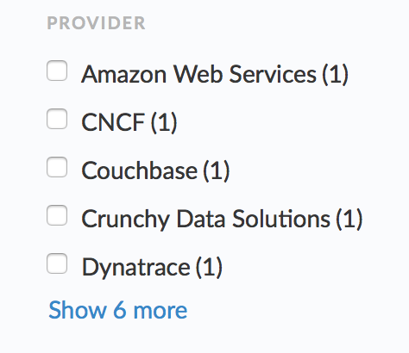
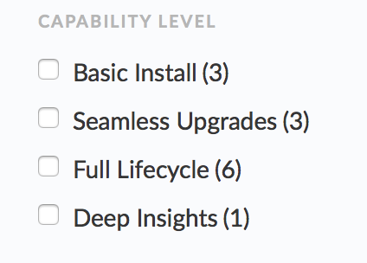
Operator hub
Some of available operators for openshift/kubernetes :
https://www.operatorhub.io

Slide 4
Ansible or Go based
There are 2 ways in which we can build our contrail operator.
Using the Ansible-Operator, underlying is go, but we could just reuse our already present roles/playbooks.
Using the Operator-sdk to write our own go code.
Operator-sdk :
Creates the templates for creating the operator.
Builds the operator image and service accounts, crds, cr etc which can be modified and used.
The apis, controller/reconcile logic should be modified
https://github.com/pvijayaragav/operators
https://learn.openshift.com/operatorframework/go-operator-podset/

Slide 5
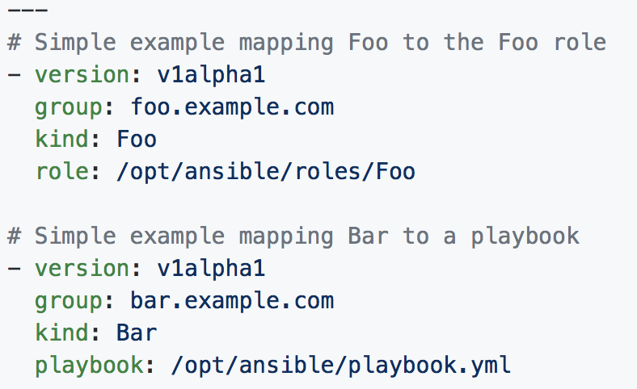
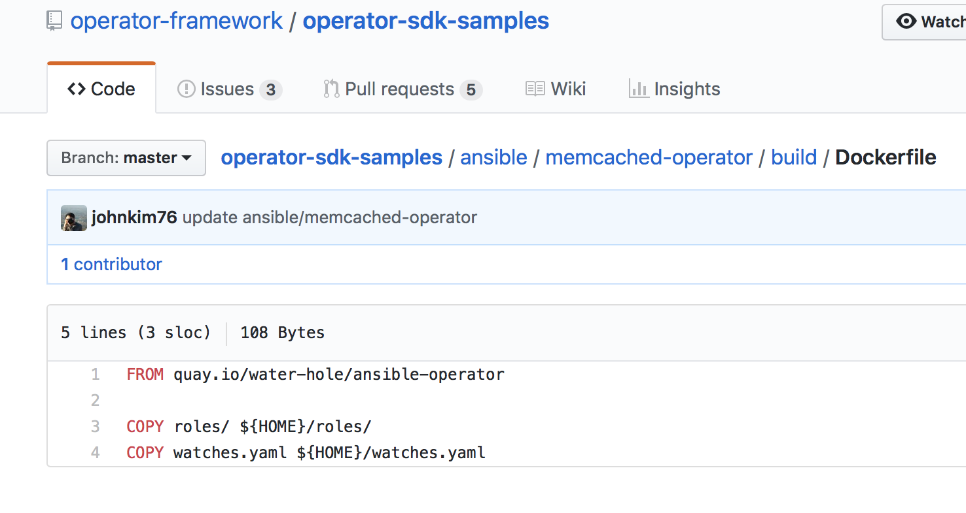
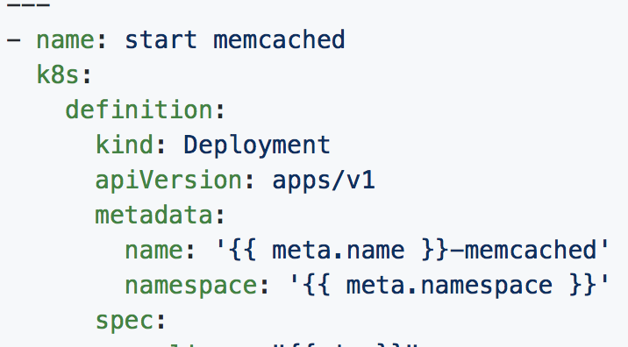
Ansible-Operator :
Uses operator sdk to build the templates, only diff is --type=ansible
Has a watches.yaml file which is copied into the Operator image using the Docker file.
https://github.com/operator-framework/operator-sdk/blob/master/doc/ansible/user-guide.md

Slide 6
Contrail Operator Requirements
Primary :
Install Contrail.
Life cycle management of Contrail.
Self healing of Contrail.
Self upgrade of Contrail.

Slide 7
Deployment ( today ) :
Contrail-ansible-deployer, Provide all node configs in the config/instances.yaml and run the playbooks.
Single yaml, bring your kubernetes cluster first then install contrail using, kubectl create -f <contrail yaml file.
Pros :
Simple and efficient.
Good level of control over deployment
Cons :
Needs knowledge of nodes and cluster information
Prone to errors ( atleast to me :) )

Slide 8
Not just Deployment ( Contrail Operator )
Operators were created for stateful applications which are managed by kubernetes environments.
Is Contrail stateful ?
What are the different states of contrail which we are interested in
How do these states depend/interact with each other.
Do we have a state diagram ie what should be the behavior of the system ?

Slide 9
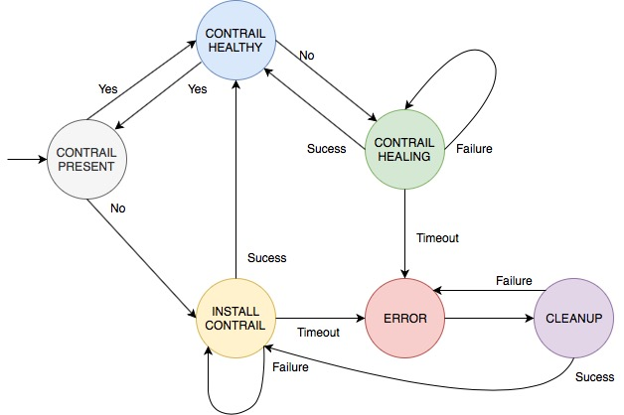
Analyzing Cluster States :

Slide 10
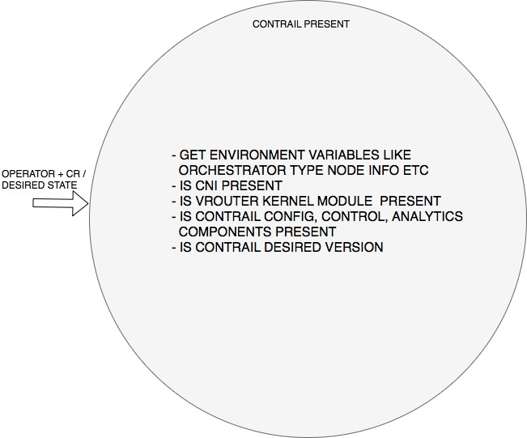

Slide 11
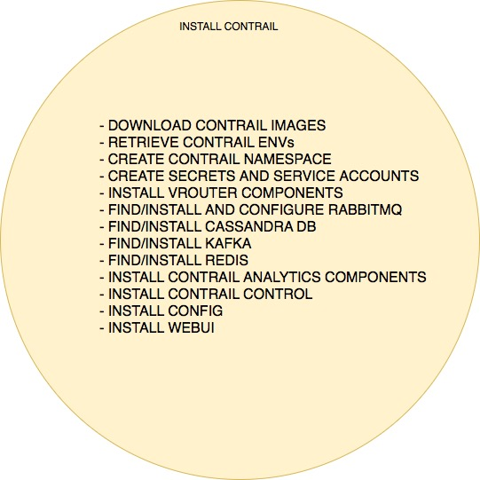

Slide 12
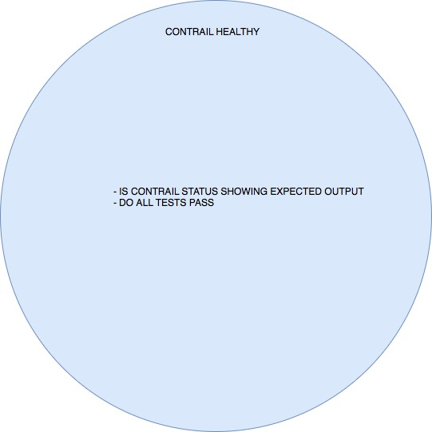

Slide 13
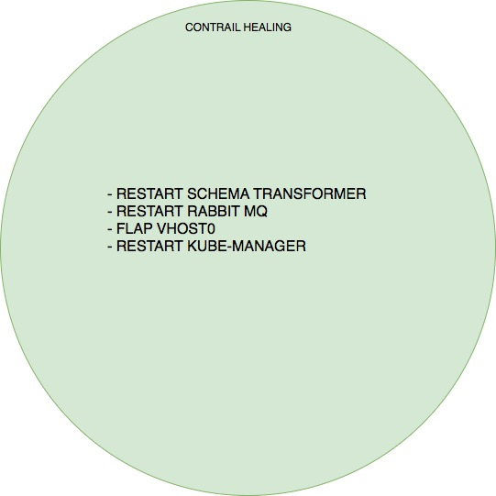

Slide 14
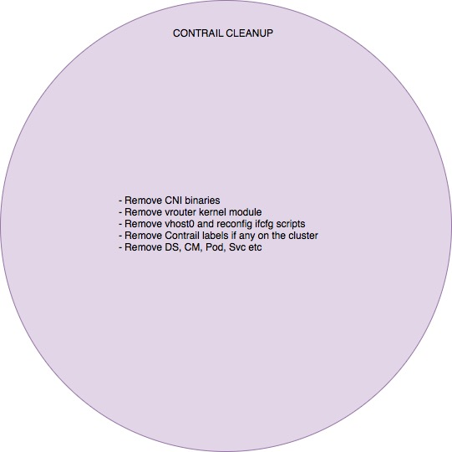

Slide 15
Analyzing Cluster Components :

